Slide 1


The correlation between content novelty and scientific impact
Wuhan University
Shiyun Wang (Presenter), Jin Mao and Yaxue Ma
September 30, 2021

Slide 2

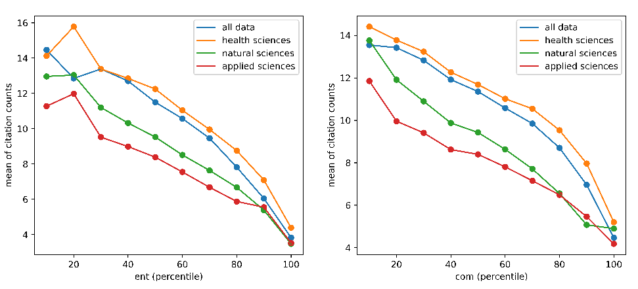
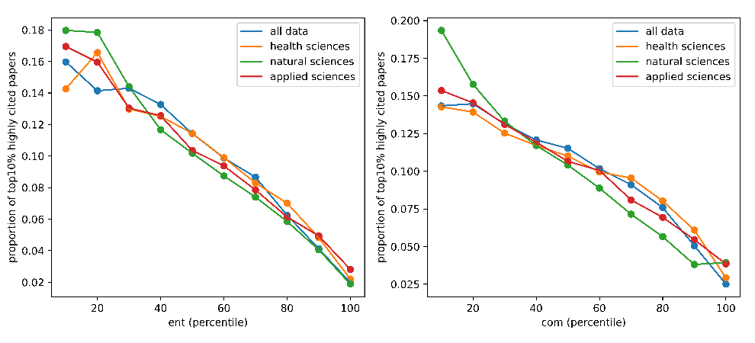

The correlation between content novelty and scientific impact
Shiyun Wang ¹, Jin Mao ¹, Yaxue Ma ²
1, School of Information Management, Wuhan University, Wuhan, Hubei, China;
2, School of Information Management, Nanjing University, Nanjing, Jiangsu, China
Introduction
Results
One major factor of research evaluation in contemporary science is citation count, which might underestimate the value of these studies in the early years.
The present paper offers new measures of novelty by exploiting knowledge content of papers, and explores the correlation between novelty and citation impact.
Table 1. The Pearson correlation coefficient between content novelty and scientific impact
Content novelty | Citation impact
 | 1-year | 3-year | 5-year | 10-year
ent | -0.114 | -0.130 | -0.126 | -0.100
com | -0.087 | -0.101 | -0.098 | -0.078
Note: The p-values were all smaller than 0.001.
Methods
Major Conclusion
Dataset: 634,738 journal articles in PubMed
Knowledge representation: knowledge entities obtained from PubTator Central system ¹ for each article
Content novelty indicators
the proportion of new knowledge entities in a paper p compared to its references:
$${ent}_{p}= \frac{n_{pi}}{n_{p}}$$
(b) the proportion of new pairwise combination of knowledge entities in paper $p$ compared to its references:
$${com}_{p}= \frac{r_{pi}}{r_{p}}$$
Figure 1: Average citation counts of papers in different novelty groups.
The content novelty is negatively correlated with the citation impact, which indicates that the widely used citation count based measures may be biased against novel research, and thus may fail to recognize novel research in science.
URL Links
¹ https://www.ncbi.nlm.nih.gov/research/pubtator/
Figure 2: Proportion of top10% highly cited papers in different novelty groups.

Slide 3
THANKS
Contact
Shiyun Wang
Email: wangsy2@whu.edu.cn
Jin Mao
Email: maojin@whu.edu.cn
Yaxue Ma
Email: myx_vicky@163.com

